Slide 1
Team 21 Standup 2
Predicting and Clustering Bird Migration Patterns Across Americas
Team: Yangkang Chen, Dean Lawrence

Slide 2
Team Plan
Task | Summary | Deadline | Yangkang | Dean
Data exploration | Visually explore qualities of dataset | Feb. 3 | X | X
Apply gridding algorithm | Implement stixel generation algorithm from AdaSTEM paper | Feb. 7 | X
Supervised learning | Apply a variety of supervised learning models to the gridded data | Feb. 14 | X | X
Prediction | Create and evaluate predictions based on supervised learning models | Feb. 18 | X | X
Unsupervised learning | Perform unsupervised learning to extract insights from predictions made by unsupervised learning models | Feb. 24 |  | X
Standups | Prepare materials to show at standups based on work completed prior to the meeting | Feb. 7, Feb. 21 | X | X
Report drafting | Complete writing of final report | Feb. 28 | X | X

Slide 3
Previous progress

Slide 4
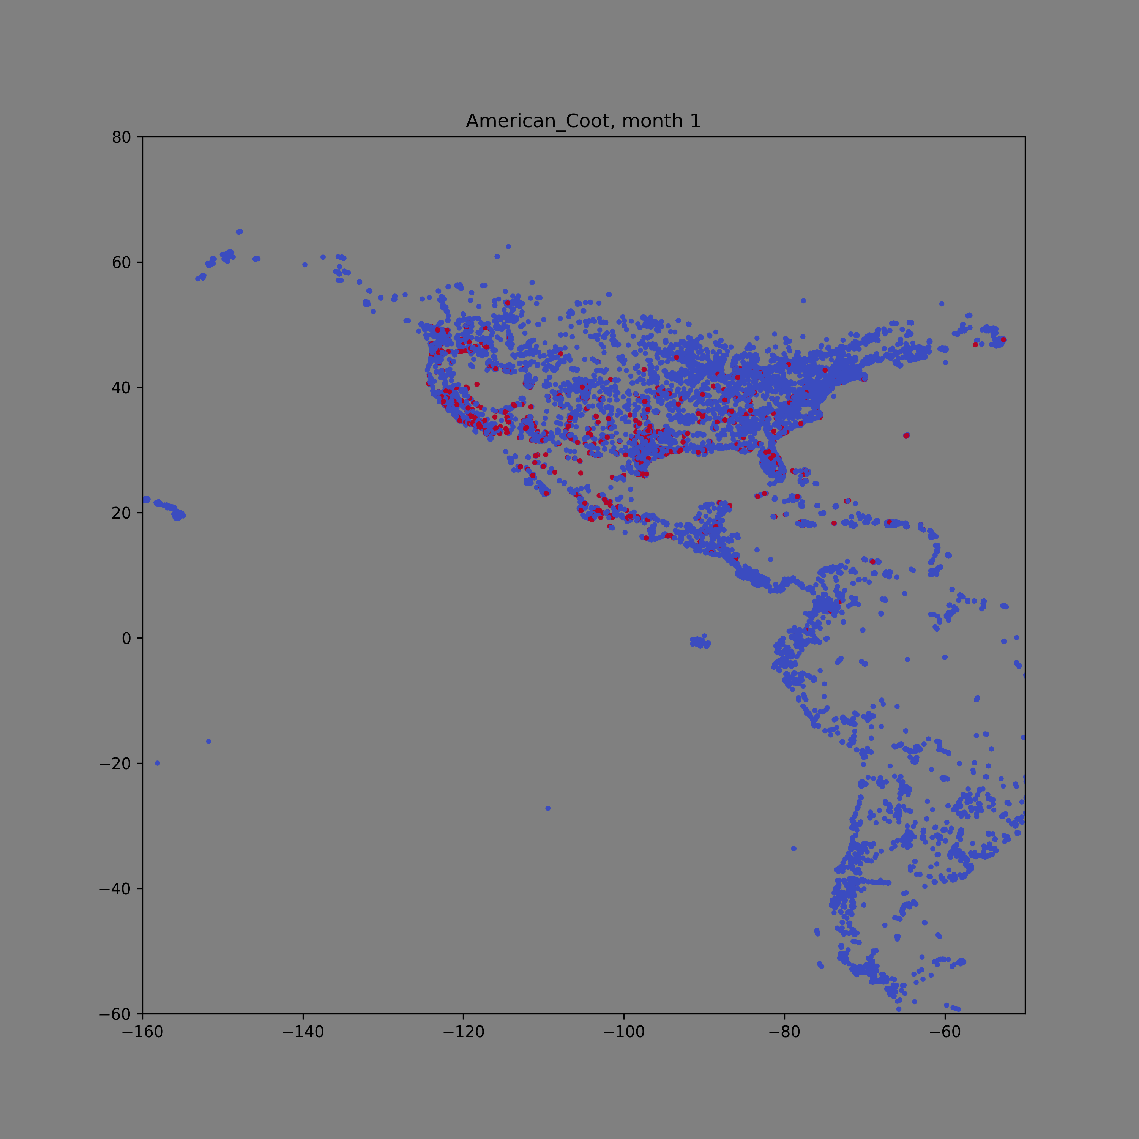

Slide 5
Data
No gridding
Gridding
Predict (adjust observation bias)
Reduce data volumn &
dimension
Supervised learning
Supervised learning
Clustering different species’ migration pattern
ensemble
evaluation
evaluation

Slide 6
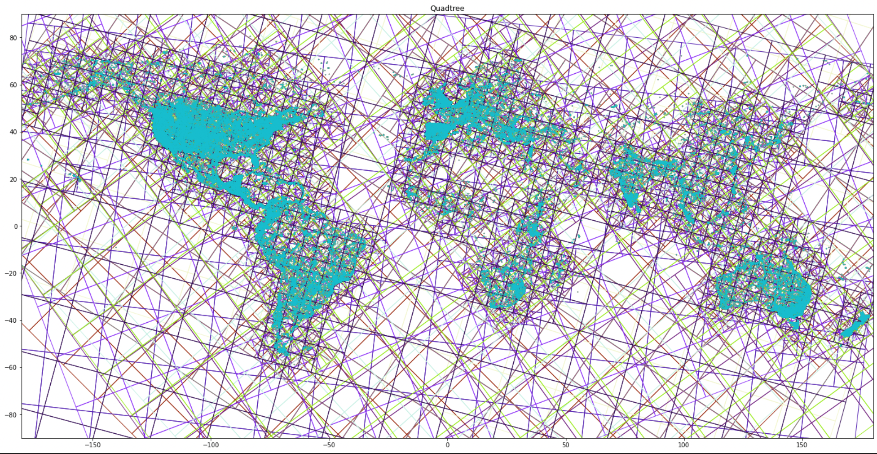
QuadTree implementation
100 spatial ensembles
Thousands of stixels for each ensembles
(spatial temporal pixel)
One base learning model for each stixel

Slide 7
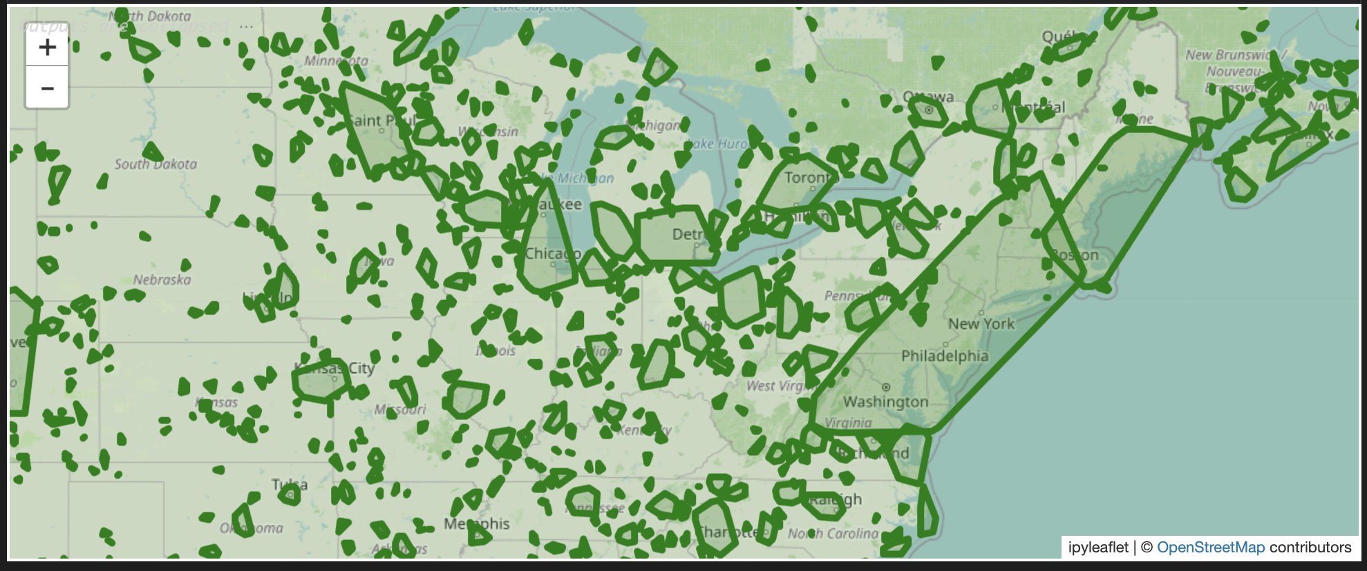

Slide 8
Location | Time | Sp1 | Sp2 | Sp3 | Sp4
(or longitude, latitude) | (date) | 1 | 1 | 0 | 1
 |  | 1 | 0 | 1 | 0
 |  | 0 | 1 | 1 | 1
 |  | 1 | 0 | 1 | 1
 |  | 0 | 1 | 0 | 1

Slide 9
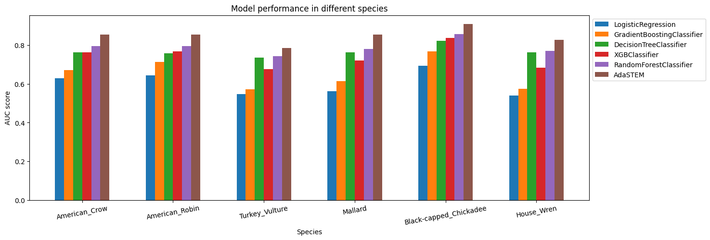
Recent Progress: Supervised part
Model performance
species | AdaSTEM | DecisionTreeClassifier | GradientBoostingClassifier | LogisticRegression | RandomForestClassifier | XGBClassifier
American_Crow | 0.864 | 0.7638 (0.0014) | 0.6718 (0.0013) | 0.63 (0.0024) | 0.794 (0.0019) | 0.7636 (0.002)
American_Robin | 0.863 | 0.7591 (0.001) | 0.7144 (0.0015) | 0.6429 (0.0017) | 0.7952 (0.001) | 0.7678 (0.002)
Black-capped_Chickadee | 0.8616 | 0.8214 (0.0021) | 0.7667 (0.0021) | 0.6932 (0.0022) | 0.8576 (0.0012) | 0.8382 (0.0017)
House_Wren | 0.8646 | 0.7635 (0.0016) | 0.574 (0.0015) | 0.5387 (0.0017) | 0.77 (0.0022) | 0.6823 (0.0015)
Mallard | 0.8615 | 0.7618 (0.0025) | 0.614 (0.0021) | 0.5609 (0.0031) | 0.7798 (0.0021) | 0.72 (0.0017)
Turkey_Vulture | 0.8633 | 0.7361 (0.0019) | 0.5723 (0.0024) | 0.5469 (0.001) | 0.7434 (0.0019) | 0.6754 (0.002)

Slide 10
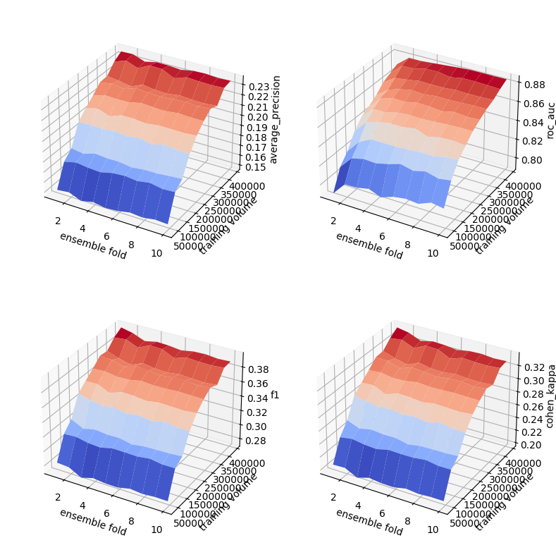
Recent Progress: Supervised part
Sensitivity Analysis & learning curve
Add another axis: grid size?

Slide 11
To do: Supervised part
Sensitivity analysis on grid size
Feature importance analysis (SHAP permutation analysis)
Error analysis: (SHAP)
Find out the feature distributions of mis-classified samples
Compare the distritutions to that of the successfully predicted samples (to see if they are outliers or abnormal values)
Find out if thses features are significantly weighted in the model

Slide 12
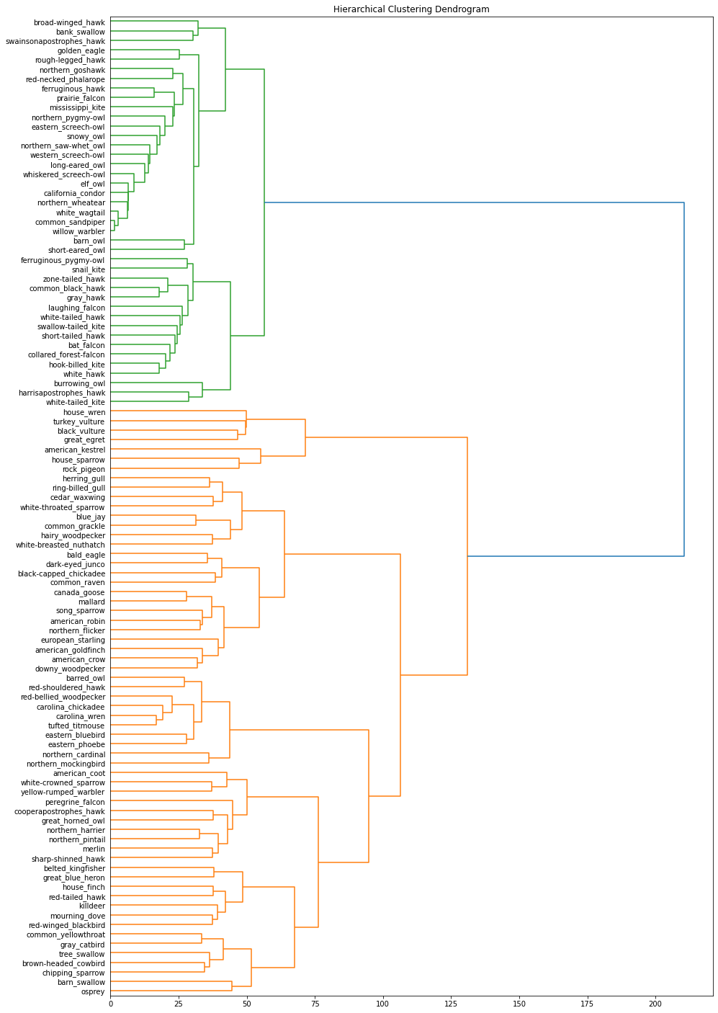
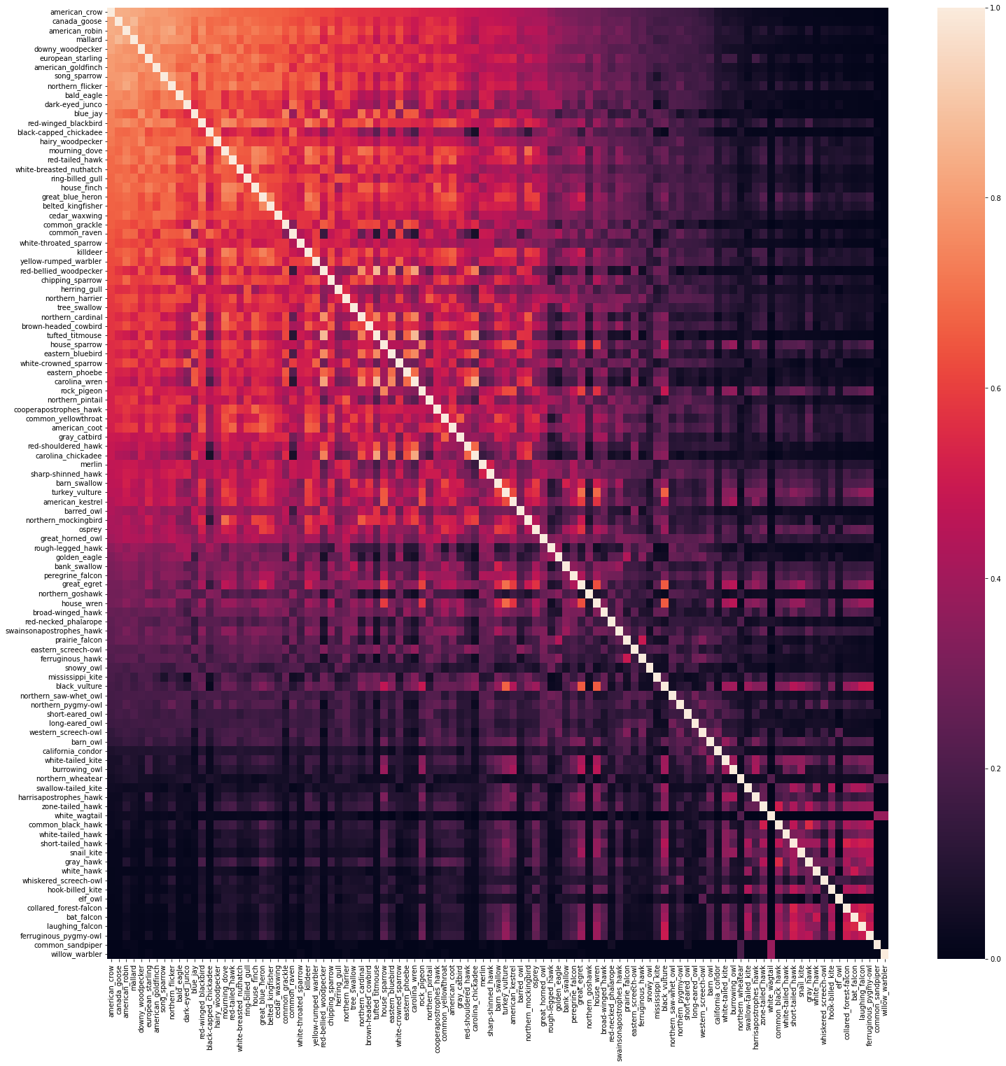
Recent Progress: Unsupervised part
ROI (regions of interest)-based clustering
Mostly carnivores
Mostly herbivores and omnivores

Slide 13
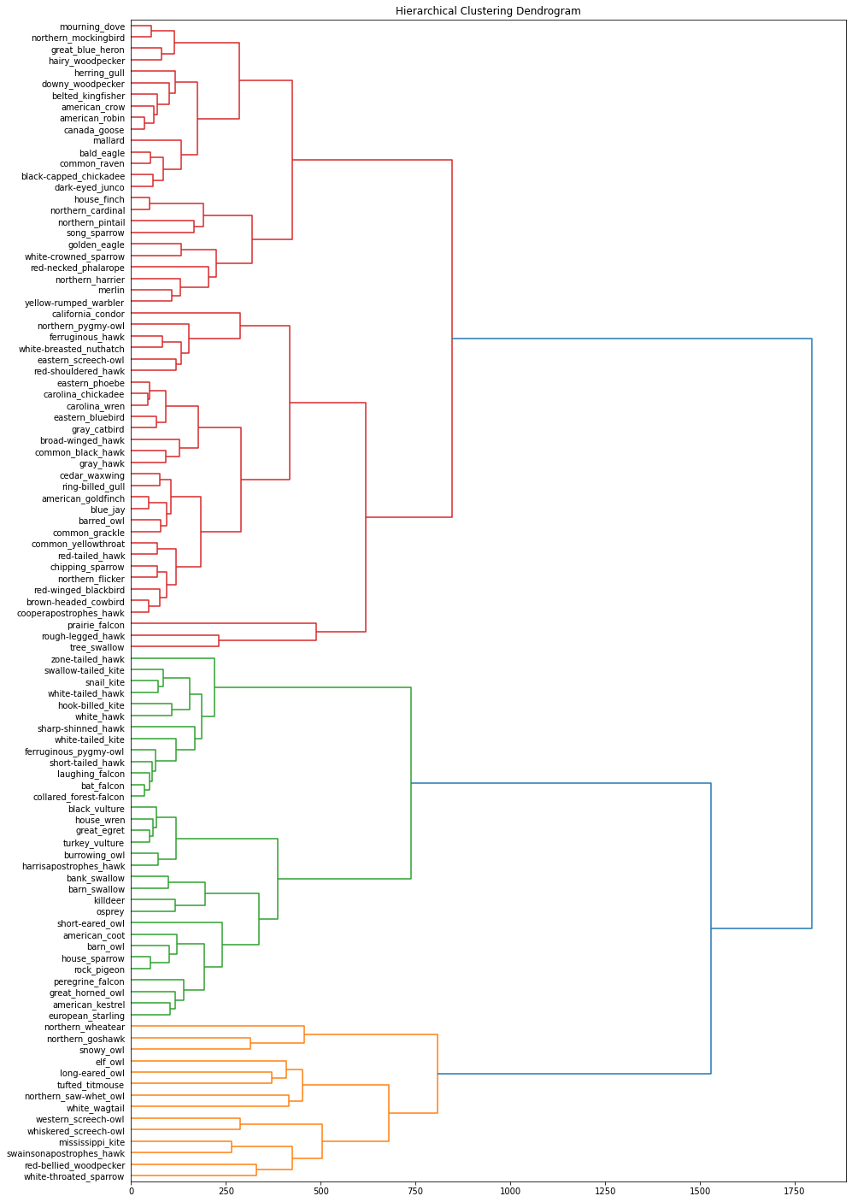
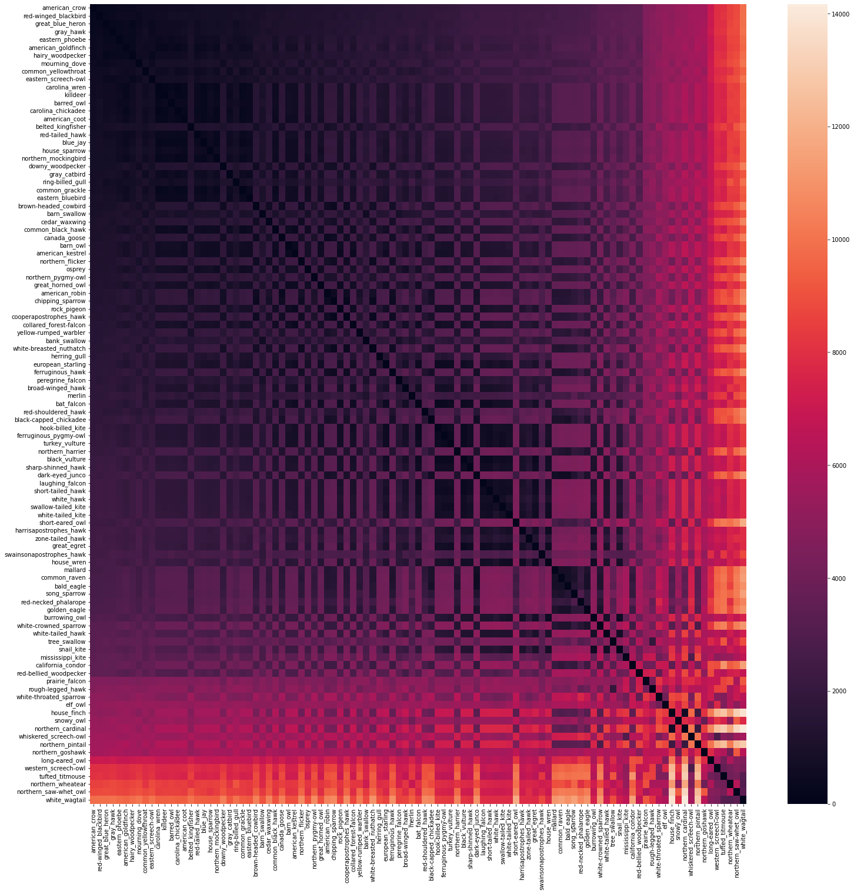
Recent Progress: Unsupervised part
Distributional parameters-based clustering
(mean, min, max of geo-distribution)
Mostly herbivores and omnivores
Mostly carnivores

Slide 14
To do: Unsupervised part
1) Robust clustering
ROI (regions of interest)-based clustering
Distributional parameters-based clustering
(mean, min, max of geo-distribution)
Combined robust clustering
2) Evaluate clusterings based on trophic level (omnivores, carnivores…)

Slide 15
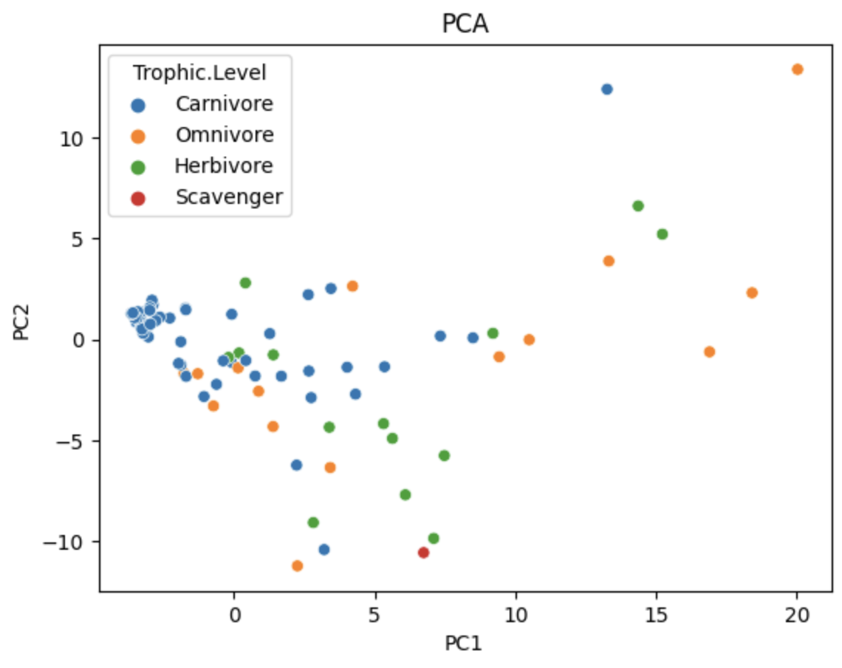
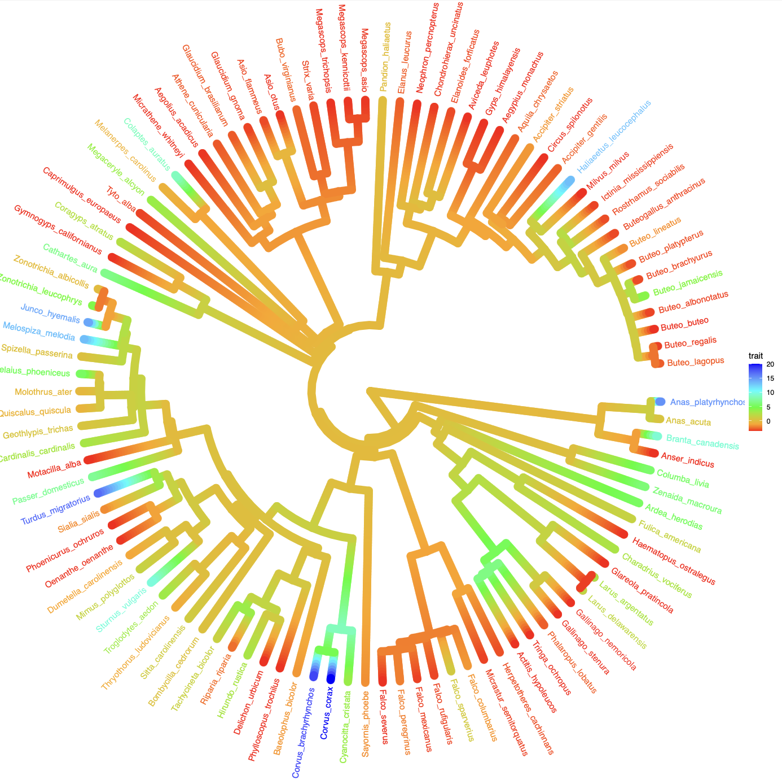
To do: other visualizations
1) Phylogenetic tree
2) Plot centered migration route for each species

Slide 17
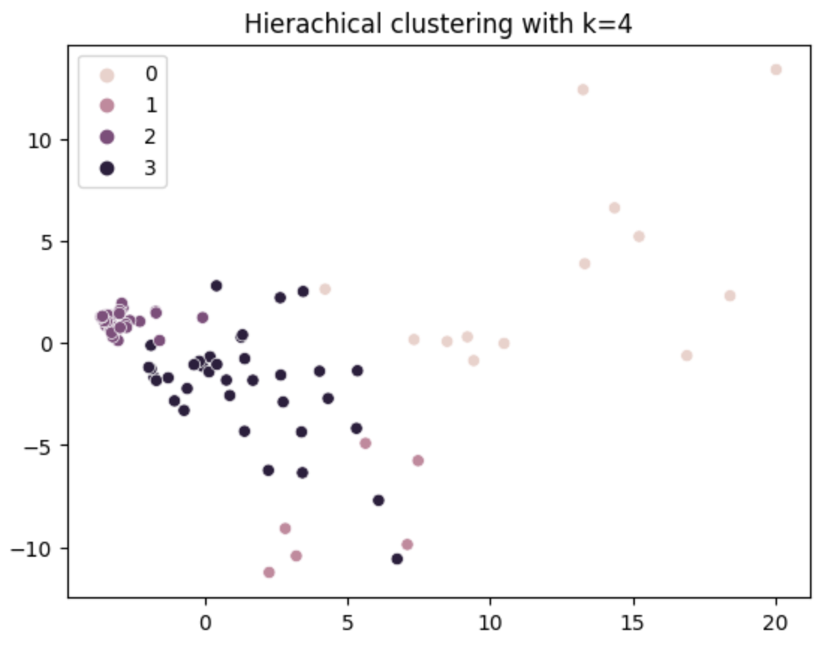

Slide 18
Recent Progress: Unsupervised part

Slide 19
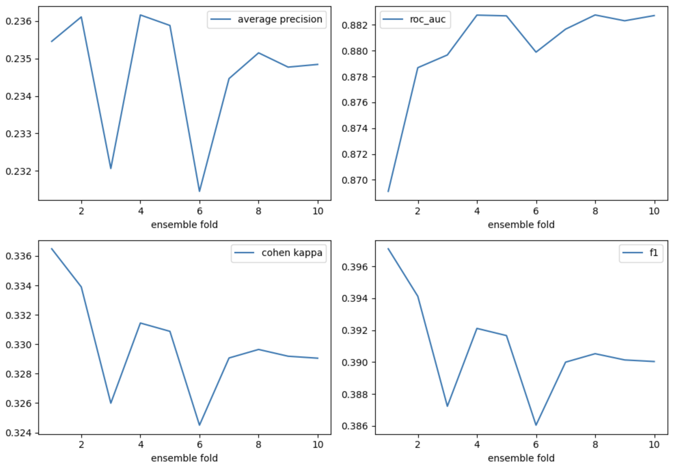
Gridding & ensemble
Single model
{
"RandomForestClassifier": {
"recall": 0.6502959877219908,
"precision": 0.726115429340841,
"ap": 0.5376533759690357,
"roc_auc": 0.7969020808394717
},
"GradientBoostingClassifier": {
"recall": 0.387360228020171,
"precision": 0.6595426971535231,
"ap": 0.37016473313859943,
"roc_auc": 0.6706541719536567
},
"DecisionTreeClassifier": {
"recall": 0.6266169699627274,
"precision": 0.6132718201813208,
"ap": 0.4541825885810646,
"roc_auc": 0.7678057392892599
},
"LogisticRegression": {
"recall": 0.24386099539574654,
"precision": 0.5239665528206336,
"ap": 0.2693217068148591,
"roc_auc": 0.5964176529083762
}
}

Slide 20
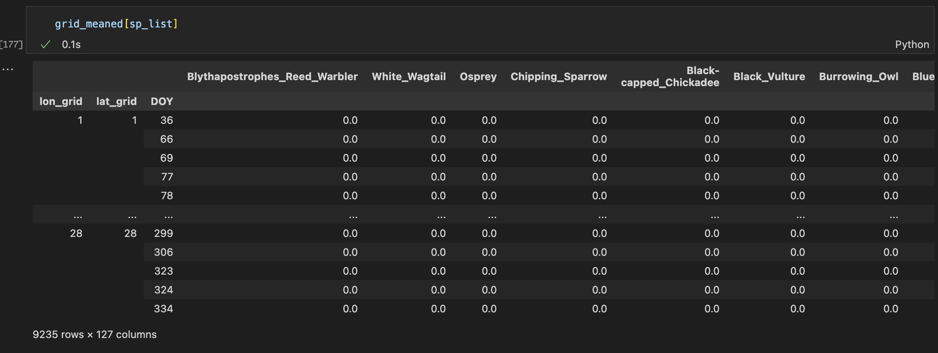

Slide 21
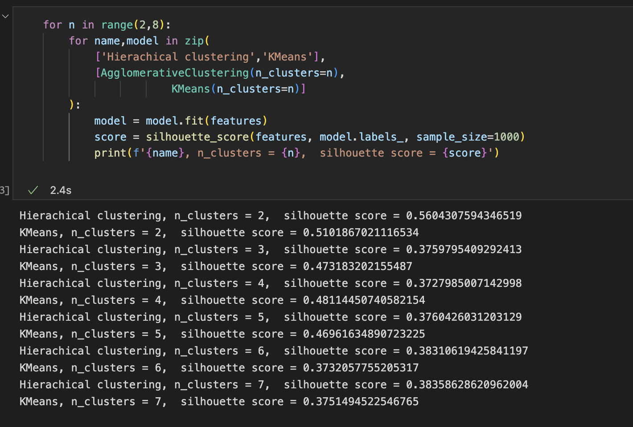

Slide 22
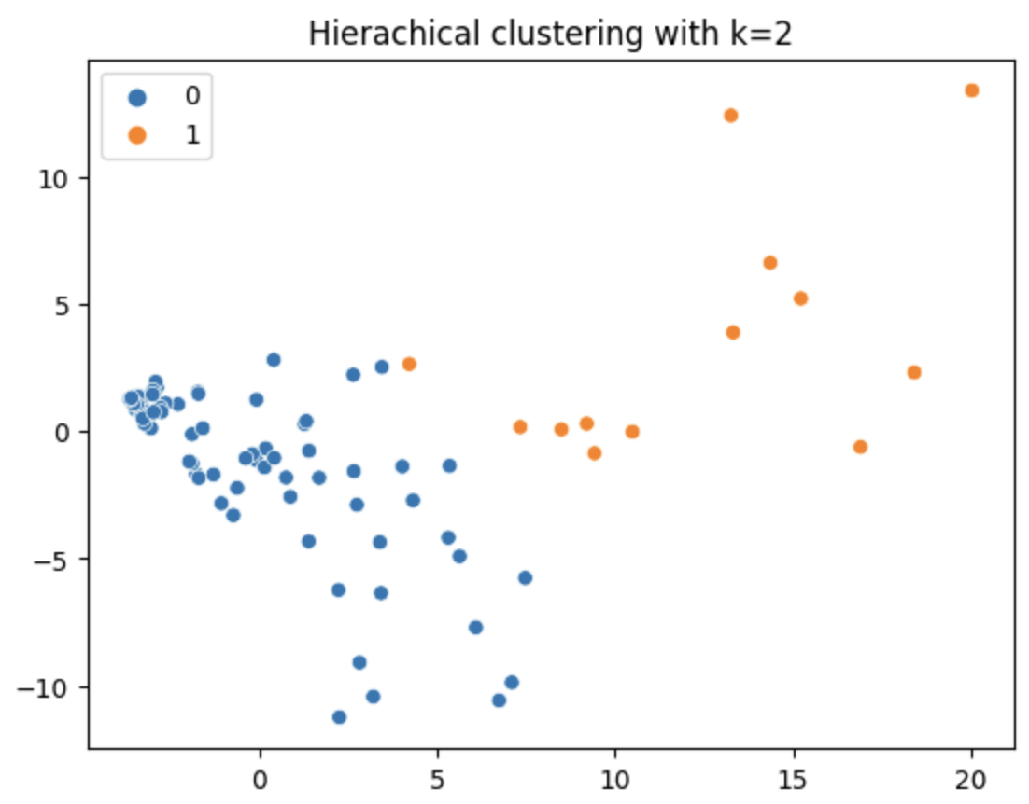

Slide 23
